Slide 1


What are some benefits that you think or hope to gain from studying Psychology?

Slide 2
Social Sciences – Match and Write!
Psychology | The systematic study of past human life and culture by the recovery and examination of remaining material evidence, such as graves, buildings, tools, and pottery
Sociology | The study of human social behaviour, especially the study of the origins, organization, institutions, and development of human society
Anthropology | The scientific study of behaviour and mental processes
Philosophy | A chronological record of events, as of the life or development of a people or institution, often including an explanation of or commentary on those events
History | Investigation of the nature, causes, or principles of reality, knowledge, or values, based on logical reasoning rather than empirical methods
Archaeology | The scientific study of the origin, the behaviour, and the physical, social, and cultural development of humans

Slide 3
Social Sciences
Psychology | The scientific study of behaviour and mental processes
Sociology | The study of human social behaviour, especially the study of the origins, organization, institutions, and development of human society
Anthropology | The scientific study of the origin, the behaviour, and the physical, social, and cultural development of humans
Philosophy | Investigation of the nature, causes, or principles of reality, knowledge, or values, based on logical reasoning rather than empirical methods
History | A chronological record of events, as of the life or development of a people or institution, often including an explanation of or commentary on those events
Archaeology | The systematic study of past human life and culture by the recovery and examination of remaining material evidence, such as graves, buildings, tools, and pottery

Slide 4
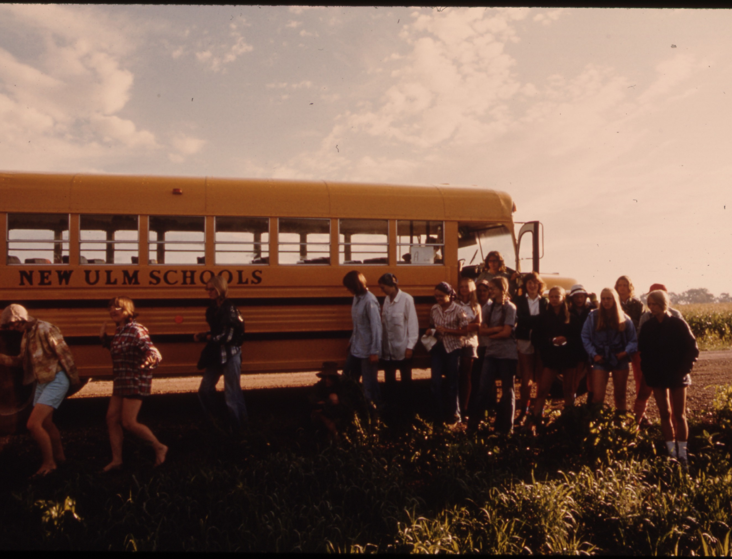
If you had to classify teenagers into four basic types, what would they be called? Describe each group.
Which group do you belong?
What branch of the social sciences would classify teenagers into subgroups?
Sociology
Write answers in a complete sentences in your books

Slide 5


HISTORY
of Psychology

Slide 6
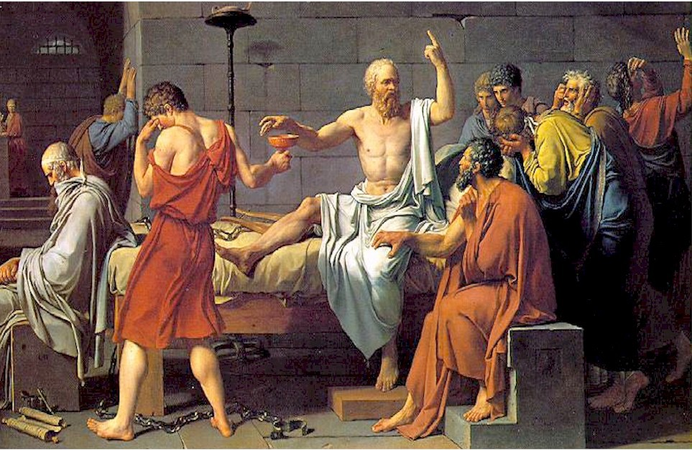
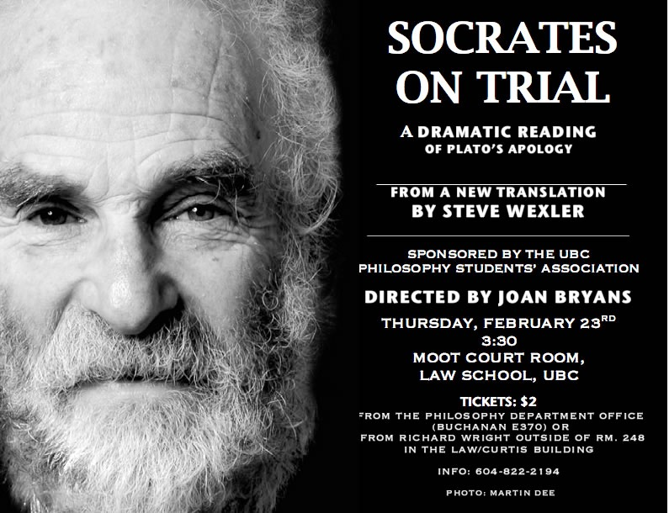
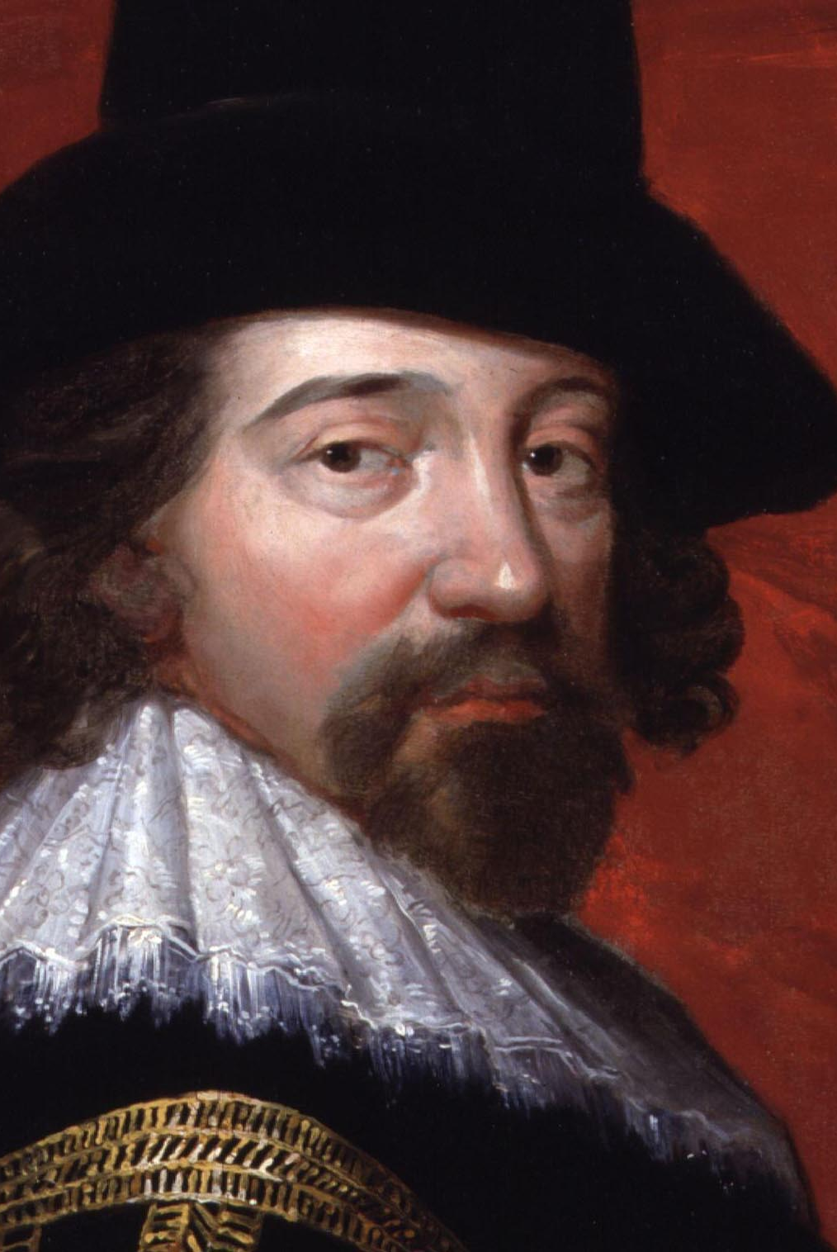
HISTORY
I.HISTORY
a. Pre-Scientific
Socrates & Plato- knowledge is born
within us.
- Introspection - Examining one’s own
thoughts & feelings
Aristotle - knowledge grows from experiences
stored in our memories.
Francis Bacon - developed the scientific method
- Modern Psych relies on this method
of Psychology

Slide 7
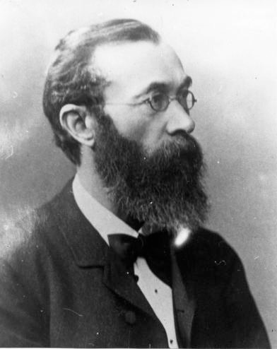

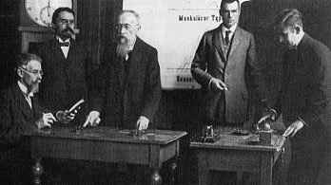
HISTORY
I.HISTORY
b. Psychology is Born - 1879
Wilhelm Wundt – established the 1st psychology experimental laboratory
• Introspection (examination of thoughts and feelings) & laboratory observations
• With Edward Titchener developed
Structuralism - conscious experience is broke into
1) Objective sensations &
2) Subjective feelings.
• The mind functions by combining
the two.
of Psychology

Slide 8
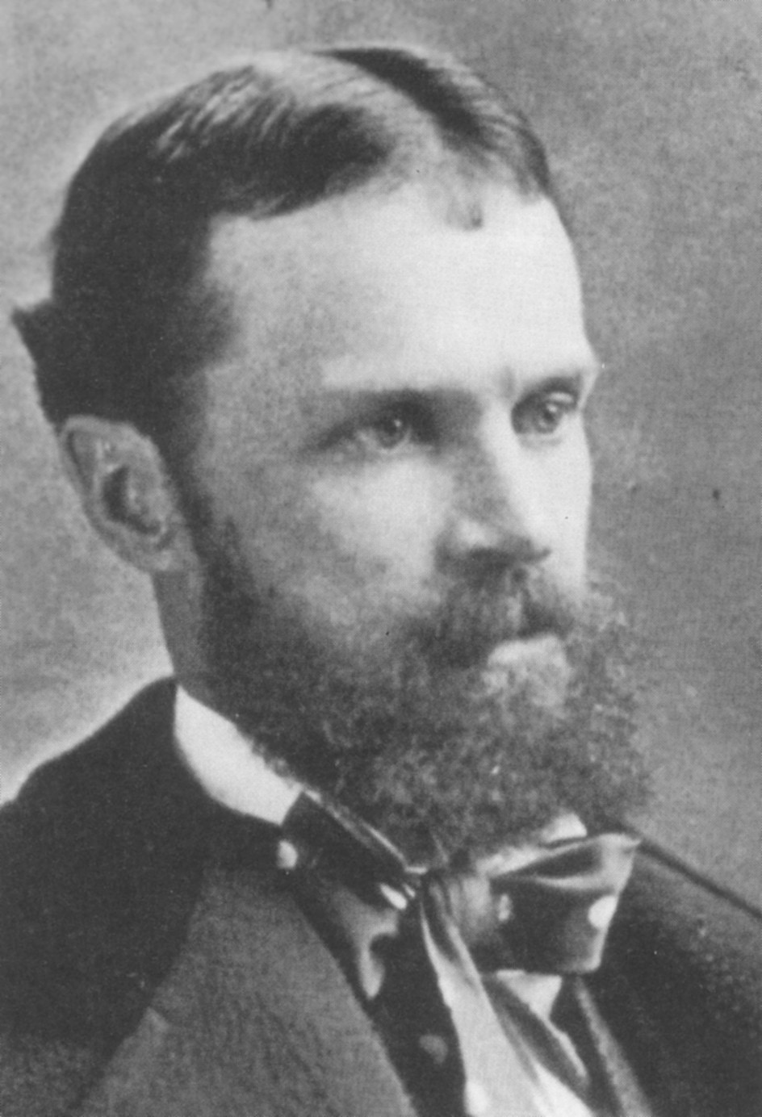

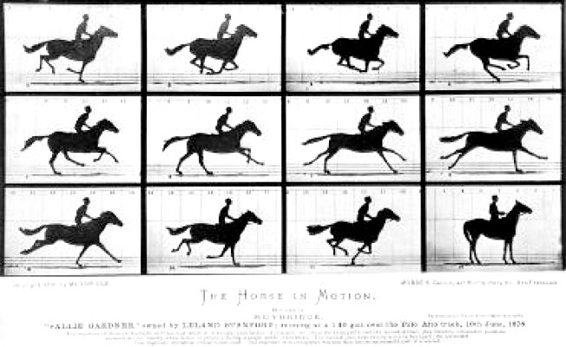
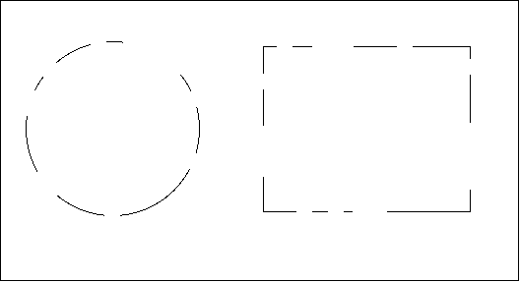
HISTORY
I.HISTORY
Gestalt - consciousness can be best understood by observing it as a total experience rather than breaking it down.
William James/Functionalism - consciousness works to help people adapt to their environments.
• Wrote the 1st Modern book of Psychology in 1890 - The Principles of Psychology.
of Psychology

Slide 9
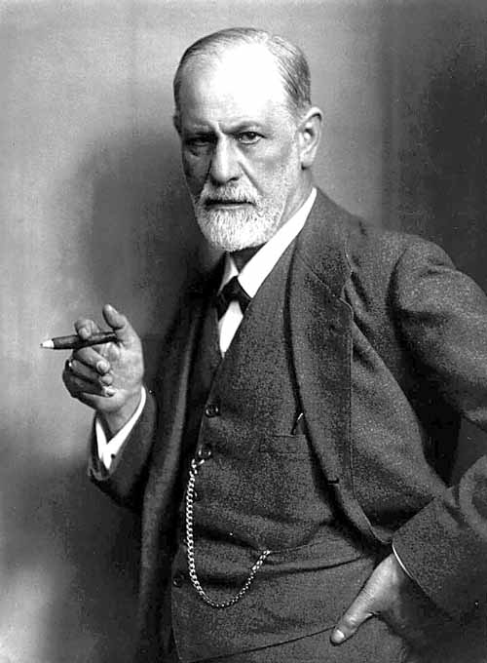
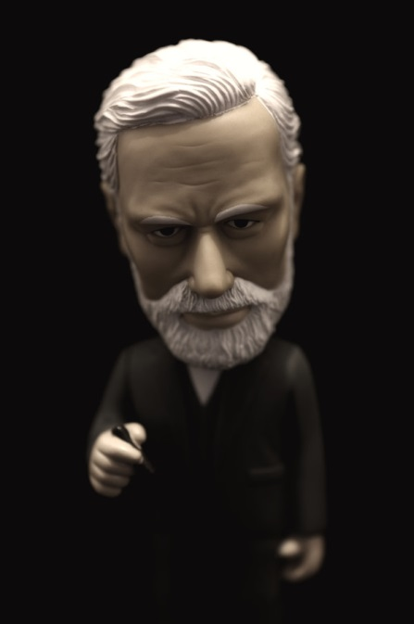
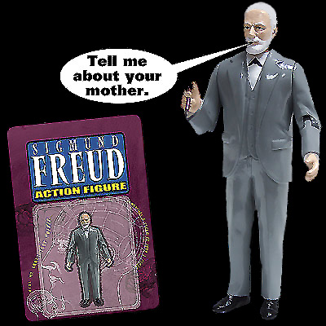
I.HISTORY
Sigmund Freud - Psychoanalysis
unconscious motives & internal conflicts determine behavior.
most famous psychologist
part of pop culture
Early 1600s
1879
1880s
1890s
1913
1930s
John B. Watson publishes “Psychology as the Behaviorist Views It”
Descartes & Bacon
develop Scientific Method
Birth of Modern Psychology - Wilhelm Wundt’s 1st Lab
William James begins work in Functionalism
Freud develops his work in psychoanalysis
B.S. Skinner details operant conditioning

Slide 10

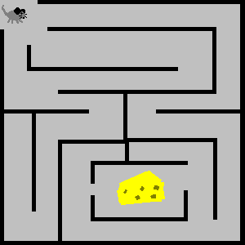
I.HISTORY
+
Notes:
Picture this. . . A rat. . . And a maze
A hungry rat is cruising through a maze. It moves along until it reaches a place where it must turn left or right. If the rat is consistently rewarded with food for turning right at that place, it will learn to turn right when it arrives there. But what does the rat think when its learning to turn right at the place in the maze? Who Knows?

Slide 11

I.HISTORY

Slide 12
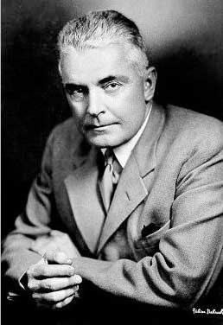


I.HISTORY
John B. Watson - Behaviorism
The study of Psych should be limited to
observable behavior
Psychology - the science of mental life
Psychology - scientific study of observable behavior
Early 1600s
1879
1880s
1890s
1913
1930s
John B. Watson publishes “Psychology as the Behaviorist Views It”
Descartes & Bacon
develop Scientific Method
Birth of Modern Psychology - Wilhelm Wundt’s 1st Lab
William James begins work in Functionalism
Freud develops his work in psychoanalysis
B.S. Skinner details operant conditioning

Slide 13
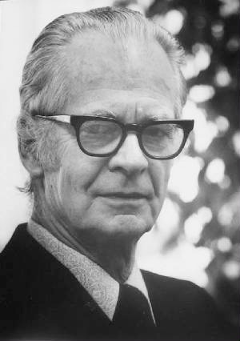
I.HISTORY
John B. Watson - Behaviorism
The study of Psych should be limited to
observable behavior
B.F. Skinner - Behaviorism
Introduced the concept of
reinforcement to control & maintain
behavior - (good doggy)
Early 1600s
1879
1880s
1890s
1913
1930s
John B. Watson publishes “Psychology as the Behaviorist Views It”
Descartes & Bacon
develop Scientific Method
Birth of Modern Psychology - Wilhelm Wundt’s 1st Lab
William James begins work in Functionalism
Freud develops his work in psychoanalysis
B.F. Skinner details operant conditioning

Slide 14
